Slide 1
Extending the Scope of Algebraic MINLP Solvers to Black- and Grey-box Optimization
Nick Sahinidis
Acknowledgments:
Alison Cozad, David Miller, Zach Wilson

Slide 2
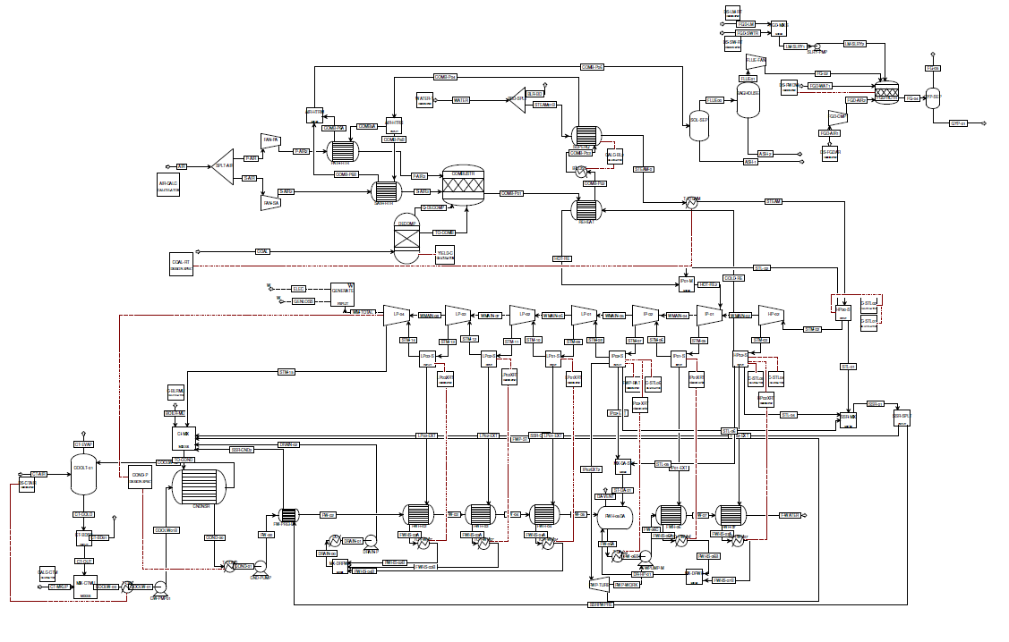
SIMULATION OPTIMIZATION
Pulverized coal plant Aspen Plus® simulation provided by the National Energy Technology Laboratory
Notes:
Simulation optimization is a very attractive option when it comes to optimizing complicated processes. High fidelity simulations can often represent real world systems with extremely high accuracy. When it comes to optimizing over these simulations, the effort and structure required to achieve this high accuracy can cost advanced optimizers speed and rigorous solutions.
The primary challenges in optimizing over any black-box process are:
-First, the absence of an algebraic model. I will explain a bit more about why this is a particularly large challenge later.
-Costly simulations, this could be the cost of raw materials for an experimental set up, or the minutes, hours, or days it can take for a simulations to converge.
-In many cases, these simulations can have noise associated with them.
-Oftentimes, a simulation cannot converge to new points without manual manipulation .

Slide 3
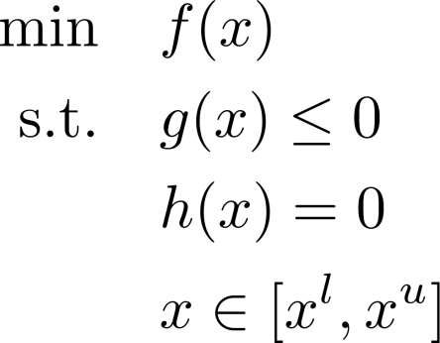
Process disaggregation
Block 1:
Simulator
Model generation
Block 2:
Simulator
Model generation
Block 3:
Simulator
Model generation
Process Simulation
Disaggregate process into process blocks
Surrogate Models
Build simple and accurate models with a functional form tailored for an optimization framework
Optimization Model
Add algebraic constraints design specs, heat/mass balances, and logic constraints

Slide 4

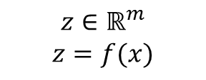



LEARNING Problem
Build a model of output variables $z$ as a function of input variables x over a specified interval
Process simulation or Experiment
$$\left(\begin{matrix}\begin{matrix}x_{1} \\ x_{2} \\ ⋮\end{matrix} \\ x_{j} \\ \begin{matrix}⋮ \\ x_{k}\end{matrix}\end{matrix}\right)$$
$$\left(\begin{matrix}\begin{matrix}z_{1} \\ z_{2} \\ ⋮\end{matrix} \\ z_{l} \\ \begin{matrix}⋮ \\ z_{m}\end{matrix}\end{matrix}\right)$$
$$x∈ℝ^{k}$$
$$x^{l}≤x≤x^{u}$$
$$z∈ℝ^{m}$$
$$z=f(x)$$
Independent variables:
Operating conditions, inlet flow properties, unit geometry
Dependent variables:
Efficiency, outlet flow conditions, conversions, heat flow, etc.
Notes:
- Automated learning of algebraic models for optimization
Tasked w/ fundamental problem of learning al algebraic model from a black box simulation given I/O data

Slide 5
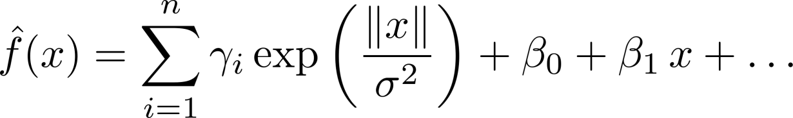
How to build the surrogates
We aim to build surrogate models that are
  Accurate
    We want to reflect the true nature of the simulation
  Simple
    Tailored for algebraic optimization
  Generated from a minimal data set
    Reduce experimental and simulation requirements
Notes:
There has been work done to abstract surrogate models from simulators then use them for optimization. Most of these methods use out of the box modeling techniques that, while accurate, can be often cumbersome or intractable in algebraic optimization.
We have developed our own modeling scheme with the aim of developing models that are:
First and foremost, accurate
To address the ease of the final optimization, we tailor the functional form and complexity of our model such that it can be tractably solved. By this, I mean that if we would like to represent the system with a small set of simple basis functions instead of larger more complex models that may arise from methods such as Kriging, Neural networks, radial basis functions, etc.
We would also like to reduce our modeling time by using as few costly simulation function evaluations as possible.

Slide 6
ALAMO
Automated Learning of Algebraic Models for Optimization
Start
Initial sampling
Initial sampling
Build surrogate model
Build surrogate model
Update training data set
Update training data set
Adaptive sampling
Adaptive sampling
Model
error
Model converged?
New model
false
Current model
true
Black-box function
Stop

Slide 7
Model complexity tradeoff
Kriging [Krige, 63]
Neural nets [McCulloch-Pitts, 43]
Radial basis functions [Buhman, 00]
Preferred region
Model accuracy
Linear response surface
Model complexity

Slide 8

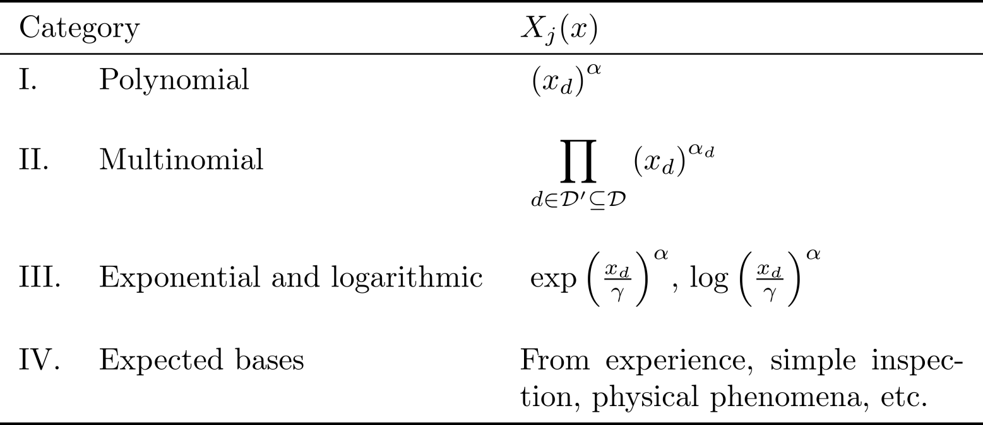
Model identification
Goal: Identify the functional form and complexity of the surrogate models
Functional form:
  General functional form is unknown: Our method will identify models with combinations of simple basis functions

Slide 9
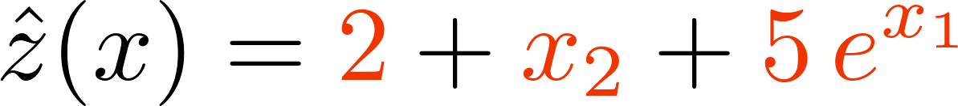
Overfitting and true error
Step 1: Define a large set of potential basis functions
Step 2: Model reduction
Error
Ideal Model
True error
Empirical error
Complexity
Underfitting
Overfitting

Slide 10
Model reduction techniques
Qualitative tradeoffs of model reduction methods
Best subset methods
    Enumerate all possible subsets
CPU modeling cost
Regularized regression techniques
  Penalize the least squares objective using the magnitude of the regressors [Tibshirani, 95]
Efficacy
Stepwise regression [Efroymson, 60]
Backward elimination [Oosterhof, 63]
Forward selection [Hamaker, 62]

Slide 11
Model sizing
Solve for the best one-term model
Solve for the best two-term model
Goodness-of-fit measure
6th term was not worth the added complexity
Final model includes 5 terms
Some measure of error that is sensitive to overfitting
(AICc, BIC, Cp)
Complexity = number of terms allowed in the model

Slide 12
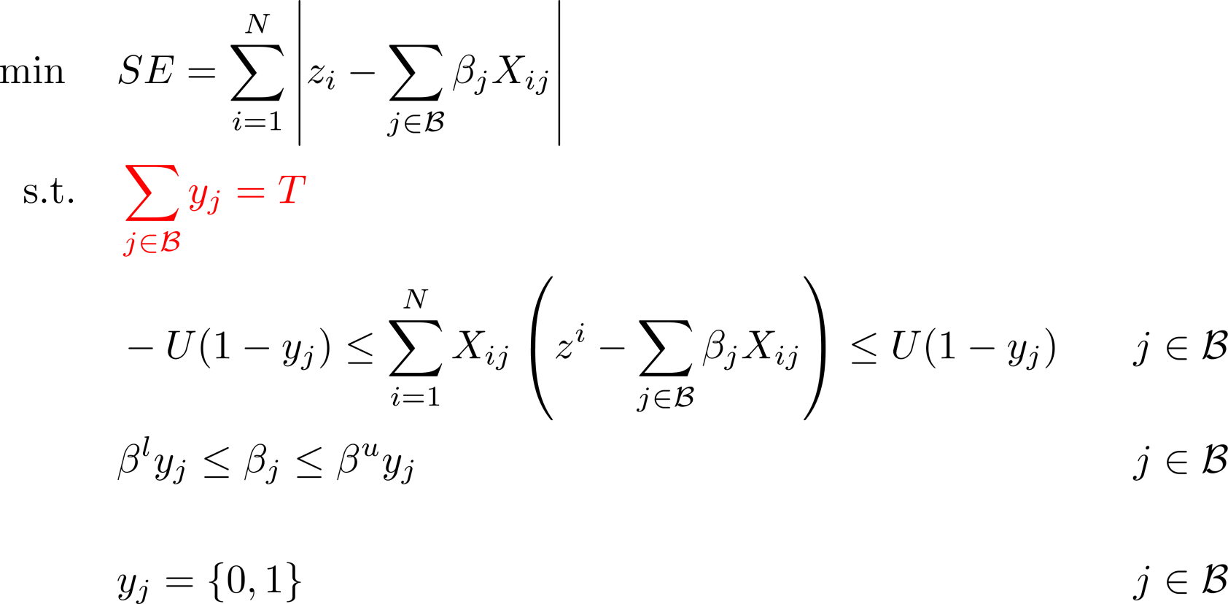
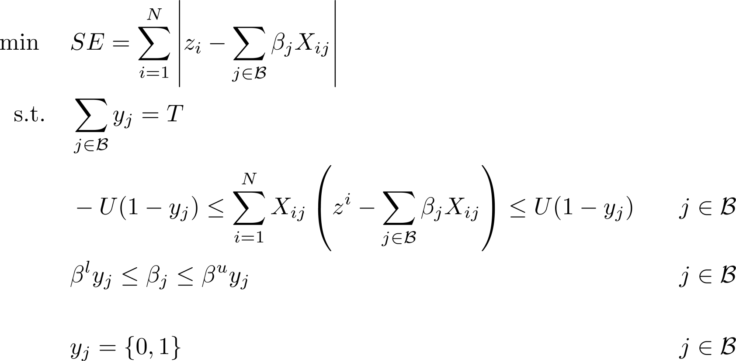
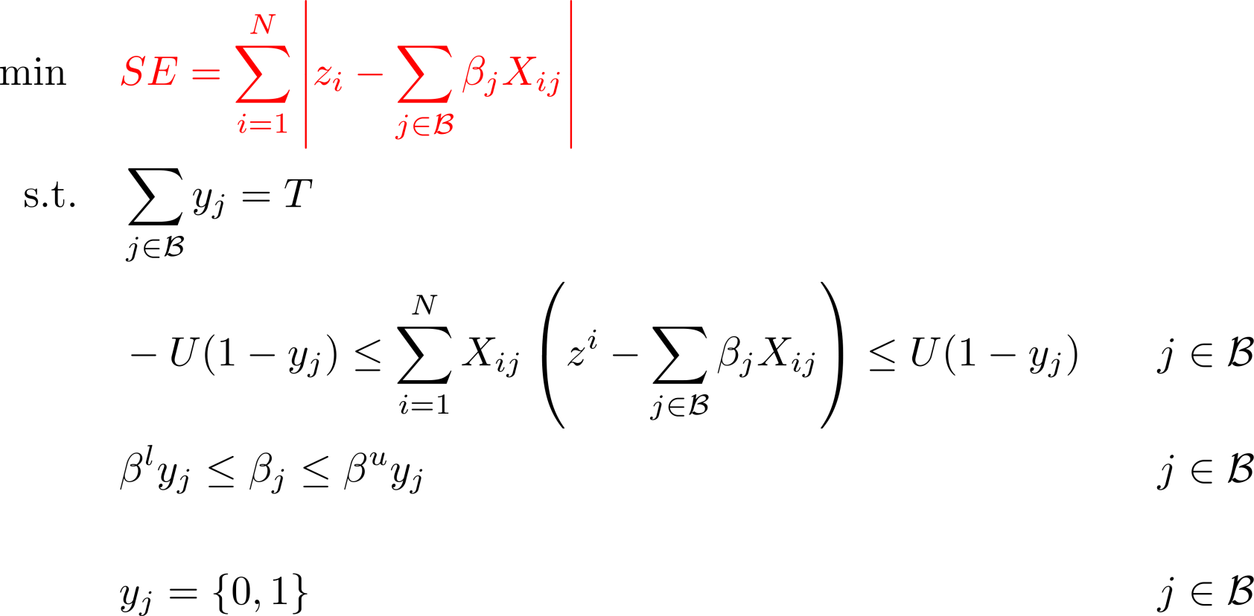
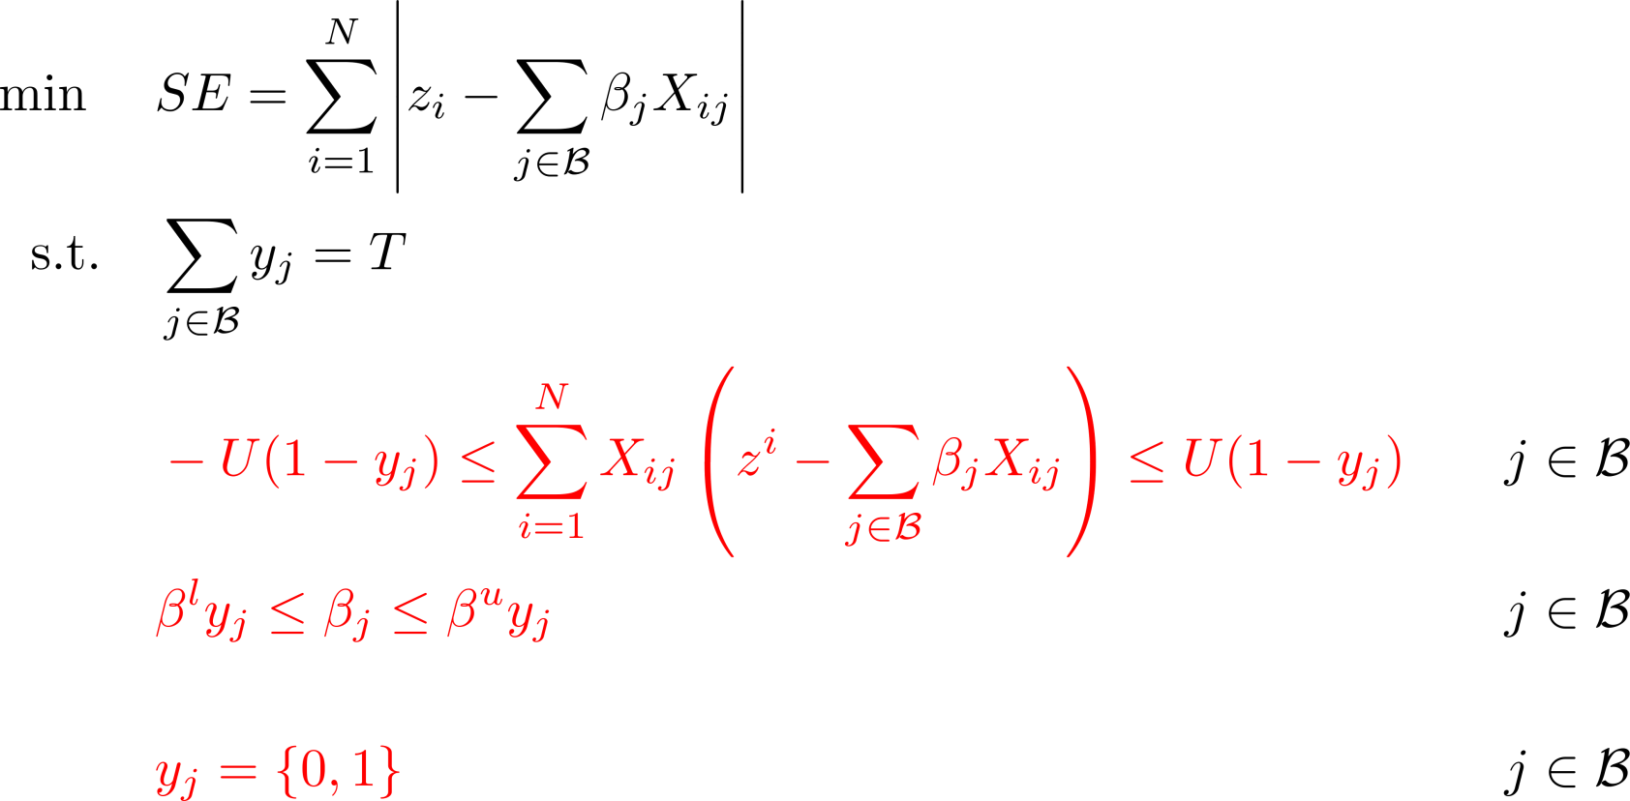

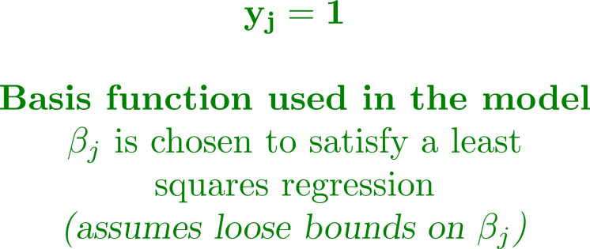

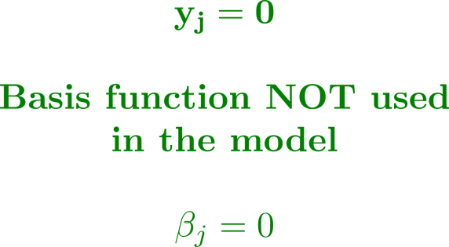


Basis function selection
Find the model with the least error
We will solve this model for increasing T until we determine a model size

Slide 13
ALAMO
Automated Learning of Algebraic Models for Optimization
Start
Initial sampling
Build surrogate model
Update training data set
Adaptive sampling
Model
error
false
Model converged?
Error maximization sampling
true
Stop

Slide 14
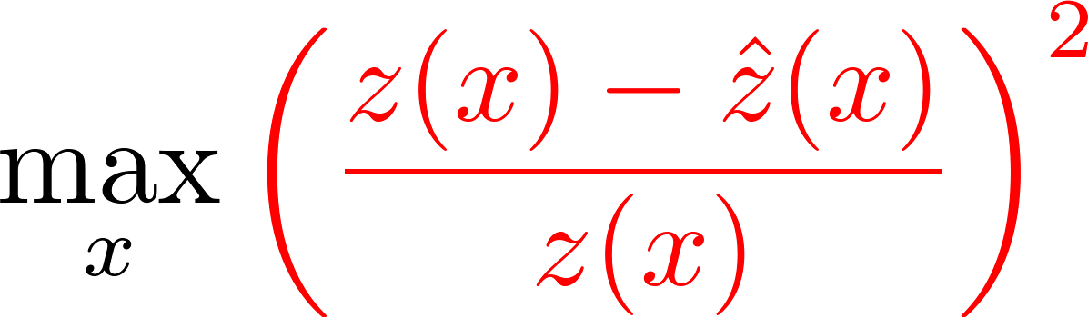
Error maximization sampling
Search the problem space for areas of model inconsistency or model mismatch
Find points that maximize the model error with respect to the independent variables
  Derivative-free solvers work well in low-dimensional spaces
  [Rios and Sahinidis, 12]
  Optimized using a black-box or derivative-free solver (SNOBFIT) [Huyer and Neumaier, 08]
Surrogate model

Slide 15
Computational results
Goal – Compare methods on three target metrics
Modeling methods compared
  ALAMO modeler – Proposed methodology
  The LASSO – The lasso regularization
  Ordinary regression – Ordinary least-squares regression
Sampling methods compared (over the same data set size)
  ALAMO sampler – Proposed error maximization technique
  Single LH – Single Latin hypercube (no feedback)
Model accuracy
Data efficiency
Model simplicity
1
2
3

Slide 16
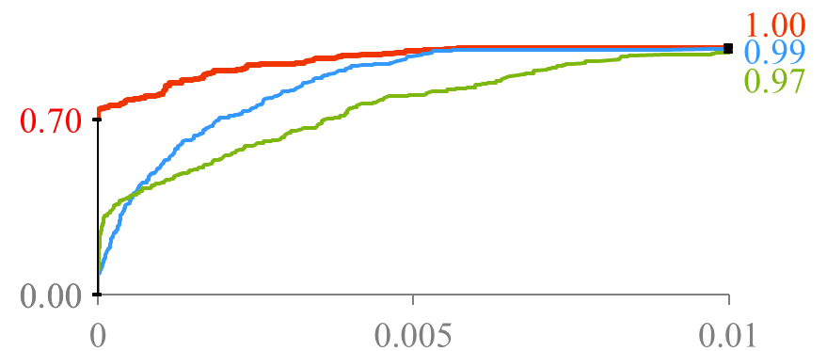
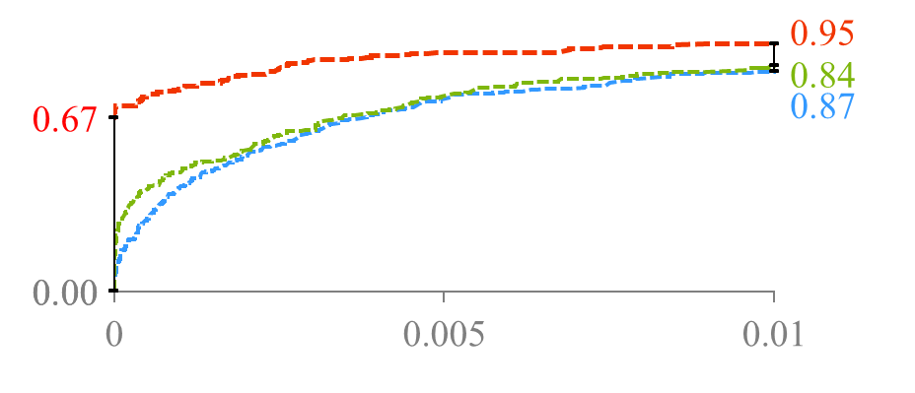
Model accuracy
Data efficiency
Model simplicity
1
2
3
Fraction of problems solved
ALAMO modeler
the lasso
Ordinary regression
70% of problems solved exactly
(0.005, 0.80)
80% of the problems had ≤0.5% error
error maximization sampling
Normalized test error
ALAMO modeler
Ordinary regression
the lasso
single Latin hypercube
Normalized test error
Notes:
ALAMO models able to solve exactly 70%, 67% of the time
EMS is able to ‘repair’ the lasso and OLR methods through repeated sampling given the same data set size

Slide 17
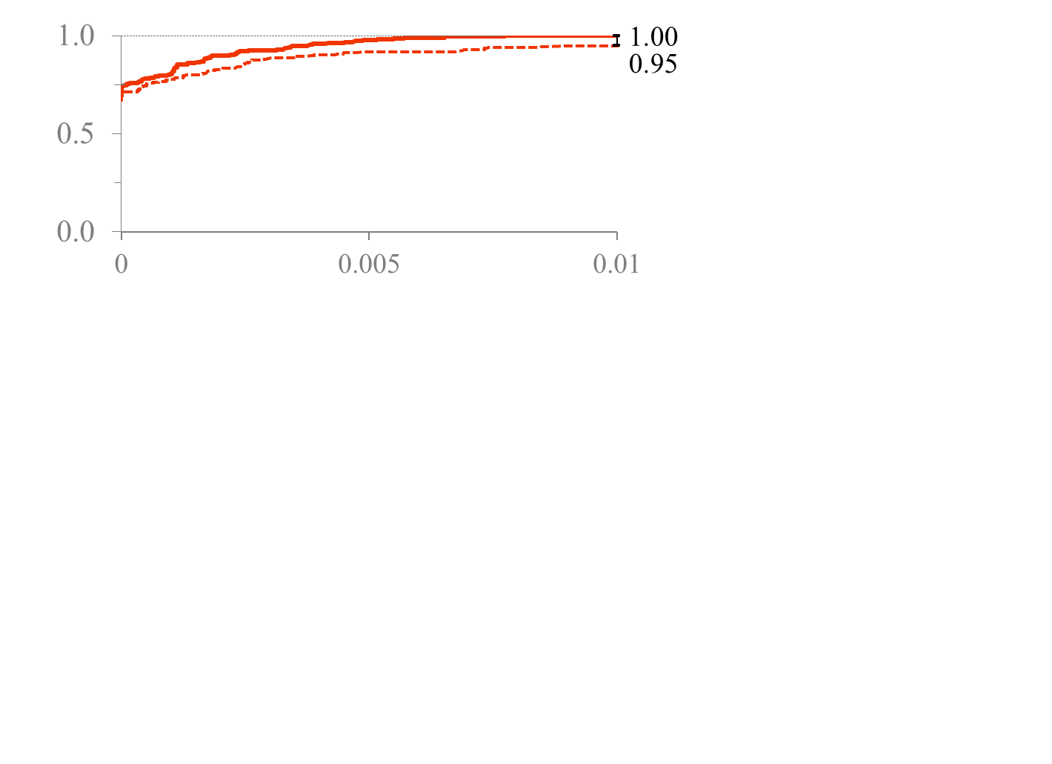
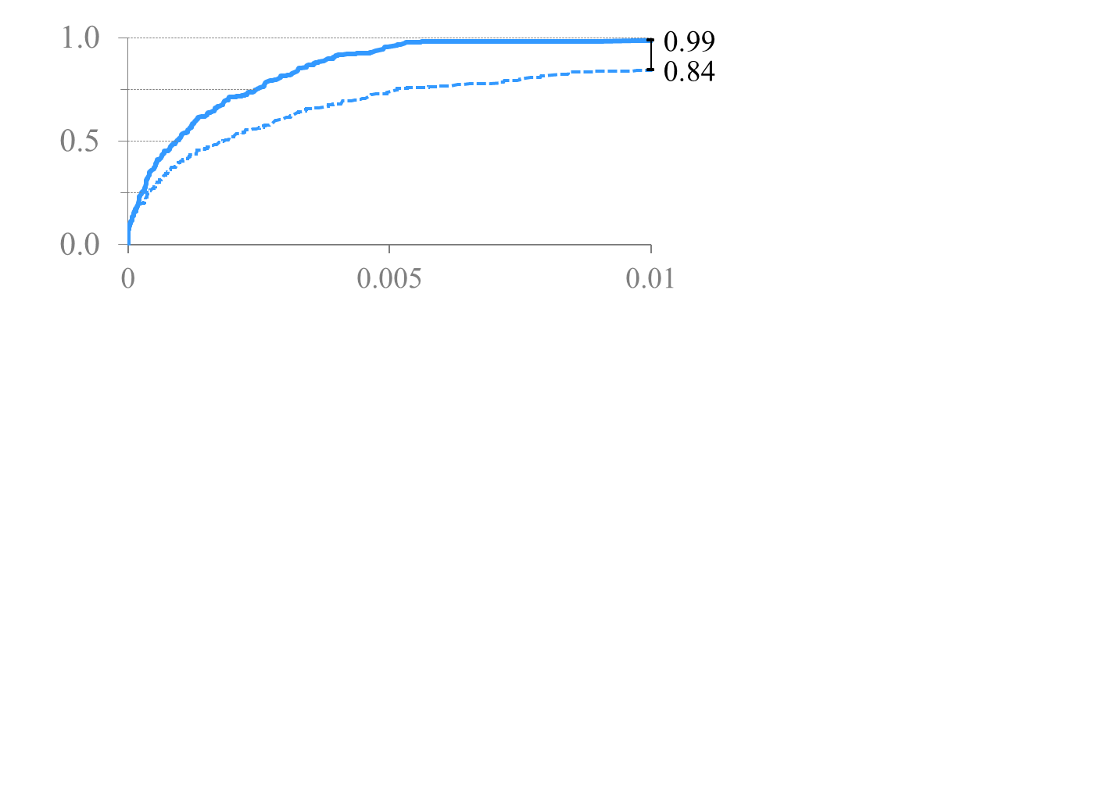
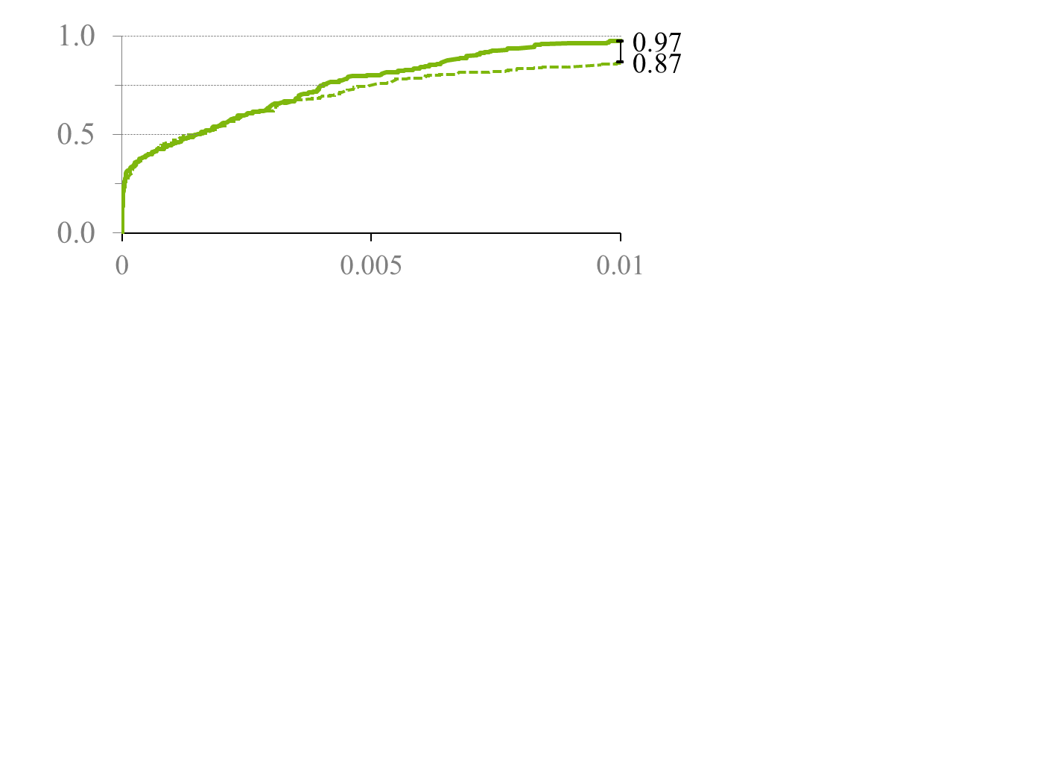
Model accuracy
Data efficiency
Model simplicity
1
2
3
Fraction of problems solved
ALAMO sampler
Single LH
ALAMO modeler
ALAMO sampler
Single LH
the lasso
ALAMO sampler
Single LH
Ordinary regression
Normalized test error

Slide 18
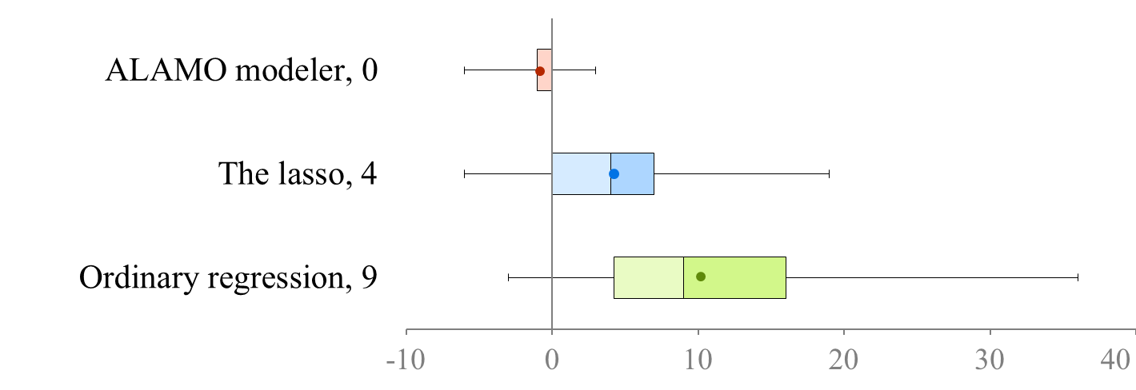

Model accuracy
Data efficiency
Model simplicity
1
2
3
Modeling type, Median
more complexity than required
Results over a test set of 45 known functions treated as black boxes with bases that are available to all modeling methods.

Slide 19

MODEL SELECTION CRITERIA
Balance fit (sum of square errors) with model complexity (number of terms in the model; denoted by p)
Corrected Akaike Information Criterion
$$AIC_{c}=N\log\left(\frac{1}{N}\sum_{i=1}^{N}{{\left(z_{i}−X_{i}β\right)}^{2}}\right)+2p+\frac{2p\left(p+1\right)}{N−p−1}$$
Mallows’ Cp
$$C_{p}=\frac{\sum_{i=1}^{N}{{\left(z_{i}−X_{i}β\right)}^{2}}}{\hat{σ^{2}}}+2p−N$$
Hannan-Quinn Information Criterion
$$HQC=N log\left(\frac{1}{N}\sum_{i=1}^{N}{{\left(z_{i}−X_{i}β\right)}^{2}}\right)+2p log⁡(\log\left(N\right))$$
Bayes Information Criterion
$$BIC=\frac{\sum_{i=1}^{N}{{\left(z_{i}−X_{i}β\right)}^{2}}}{\hat{σ^{2}}}+p log⁡(N)$$
Mean Squared Error
$$MSE=\frac{\sum_{i=1}^{N}{{\left(z_{i}−X_{i}β\right)}^{2}}}{N−p−1}$$

Slide 20
CPU TIME Comparison
Eight benchmarks from the UCI and CMU data sets
Seventy noisy data sets were generated with multicolinearity and increasing problem size (number of bases)
BIC solves more than two orders of magnitude faster than AIC, MSE and HQC
  Optimized directly via a single mixed-integer convex quadratic model

Slide 21
MODEL QUALITY Comparison
BIC leads to smaller, more accurate models
  Larger penalty for model complexity

Slide 22
ALAMO remarks
Surrogate model
New surrogate model
Error maximization
Rebuild model
Expanding the scope of algebraic optimization
  Using low-complexity surrogate models to strike a balance between optimal decision-making and model fidelity
Surrogate model identification
  Simple, accurate model identification – Integer optimization
Error maximization sampling
  More information found per simulated data point

Slide 23
THEORY utilization
empirical data
non-empirical information
Use freely available system knowledge to strengthen model
  Physical limits
  First-principles knowledge
  Intuition
Non-empirical restrictions can be applied to general regression problems

Slide 24
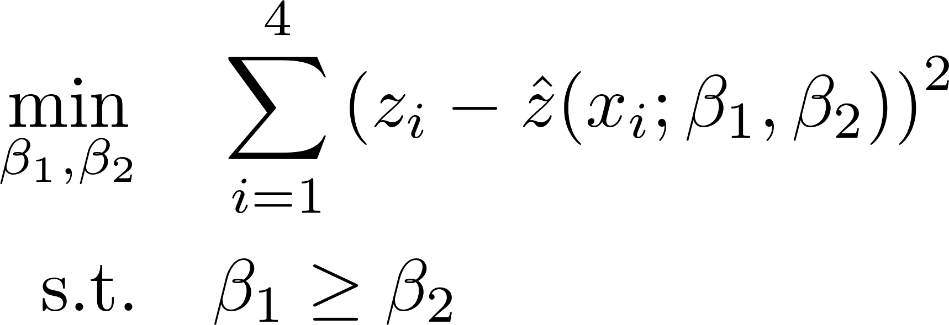
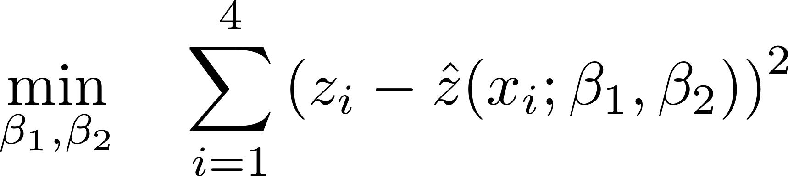
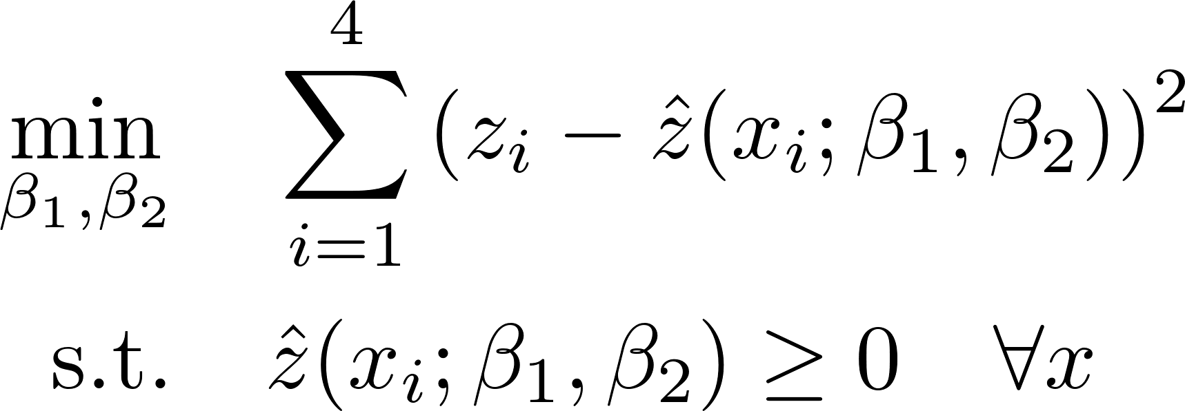
Constrained regression
Challenging due to the semi-infinite nature of the regression constraints
Standard regression
easy
Surrogate model
tough
Notes:
Use intuitive restrictions among predictor and response variables to imply nonintuitive relationships between regression parameters

Slide 25
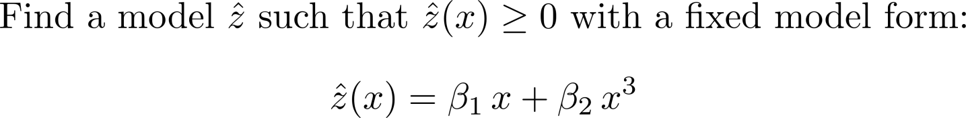
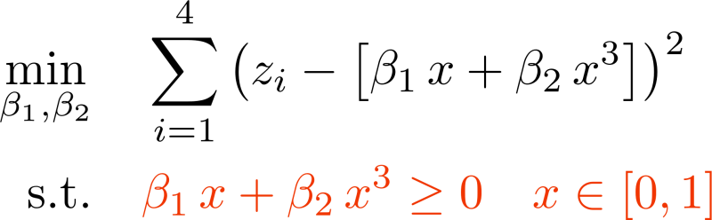
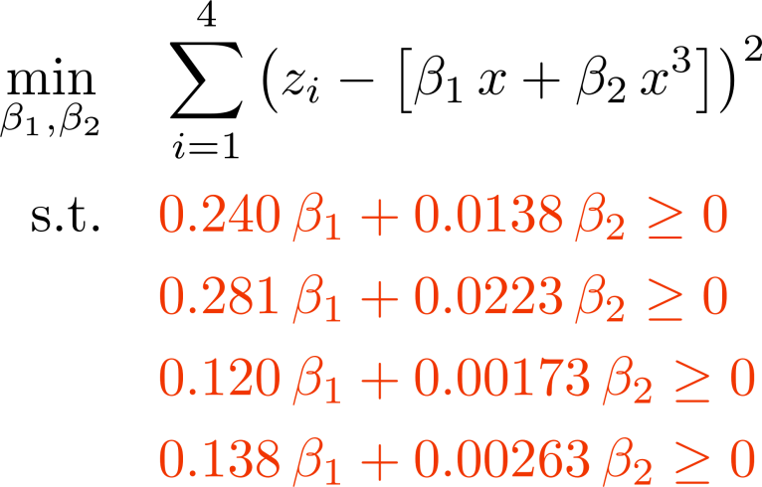
Implied parameter restrictions
Step 1: Formulate constraint in z- and x-space
Step 2: Identify a sufficient set of β-space constraints
1 parametric constraint
4 β-constraints

Slide 26







Types of Restrictions
Response bounds
Response bounds
Individual responses
Individual responses
Multiple responses
Multiple responses
pressure, temperature, compositions
mass and energy balances, physical limitations
mass balances, sum-to-one, state variables
Response derivatives
Response derivatives
Alternative domains
Alternative domains
Boundary conditions
Boundary conditions
monotonicity, numerical properties, convexity
safe extrapolation, boundary conditions
velocity profile model
safe extrapolation, boundary conditions
Extrapolation zone
Problem Space
Add
no slip

Slide 27
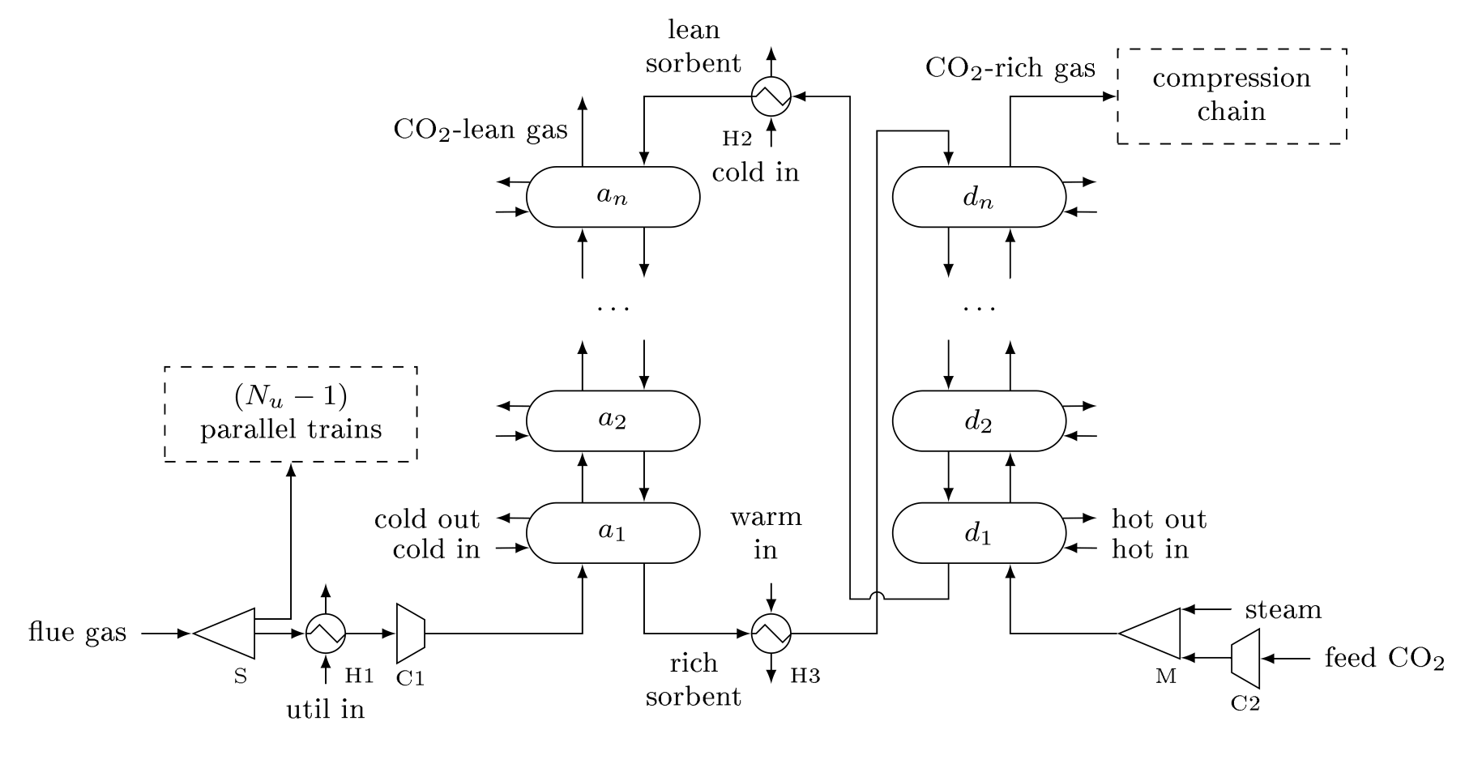
CARBON CAPTURE SYSTEM DESIGN
Surrogate models for each reactor and technology used
Discrete decisions: How many units? Parallel trains?
What technology used for each reactor?
Continuous decisions: Unit geometries
Operating conditions: Vessel temperature and pressure, flow rates, compositions

Slide 28
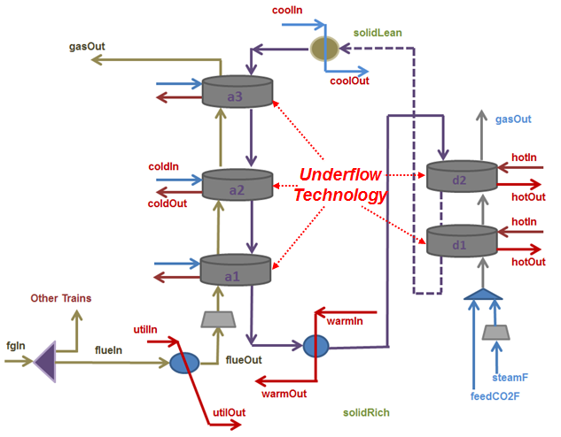
SUPERSTRUCTURE OPTIMIZATION
Mixed-integer nonlinear programming model
  Economic model
  Process model
    Material balances
    Hydrodynamic/Energy balances
    Reactor surrogate models
  Link between economic model and process model
  Binary variable constraints
  Bounds for variables

Slide 29
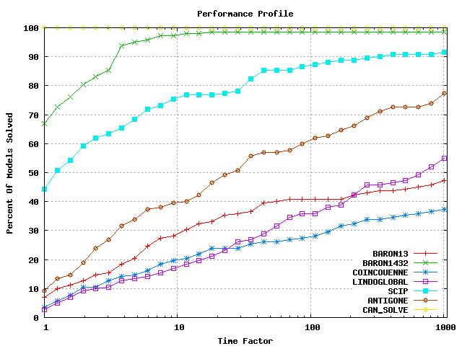
GLOBAL MINLP SOLVERS on cmu/ibmlib
BARON 14
SCIP
ANTIGONE
LINDOGLOBAL
BARON 13
COUENNE

Slide 30
conclusions
ALAMO provides algebraic models that are
  Accurate and simple
  Generated from a minimal number of function evaluations
ALAMO’s constrained regression facility allows modeling of
  Bounds on response variables
  Convexity/monotonicity of response variables
On-going efforts
    Uncertainty quantification
    Symbolic regression
ALAMO site: archimedes.cheme.cmu.edu/?q=alamo

